Slide 1
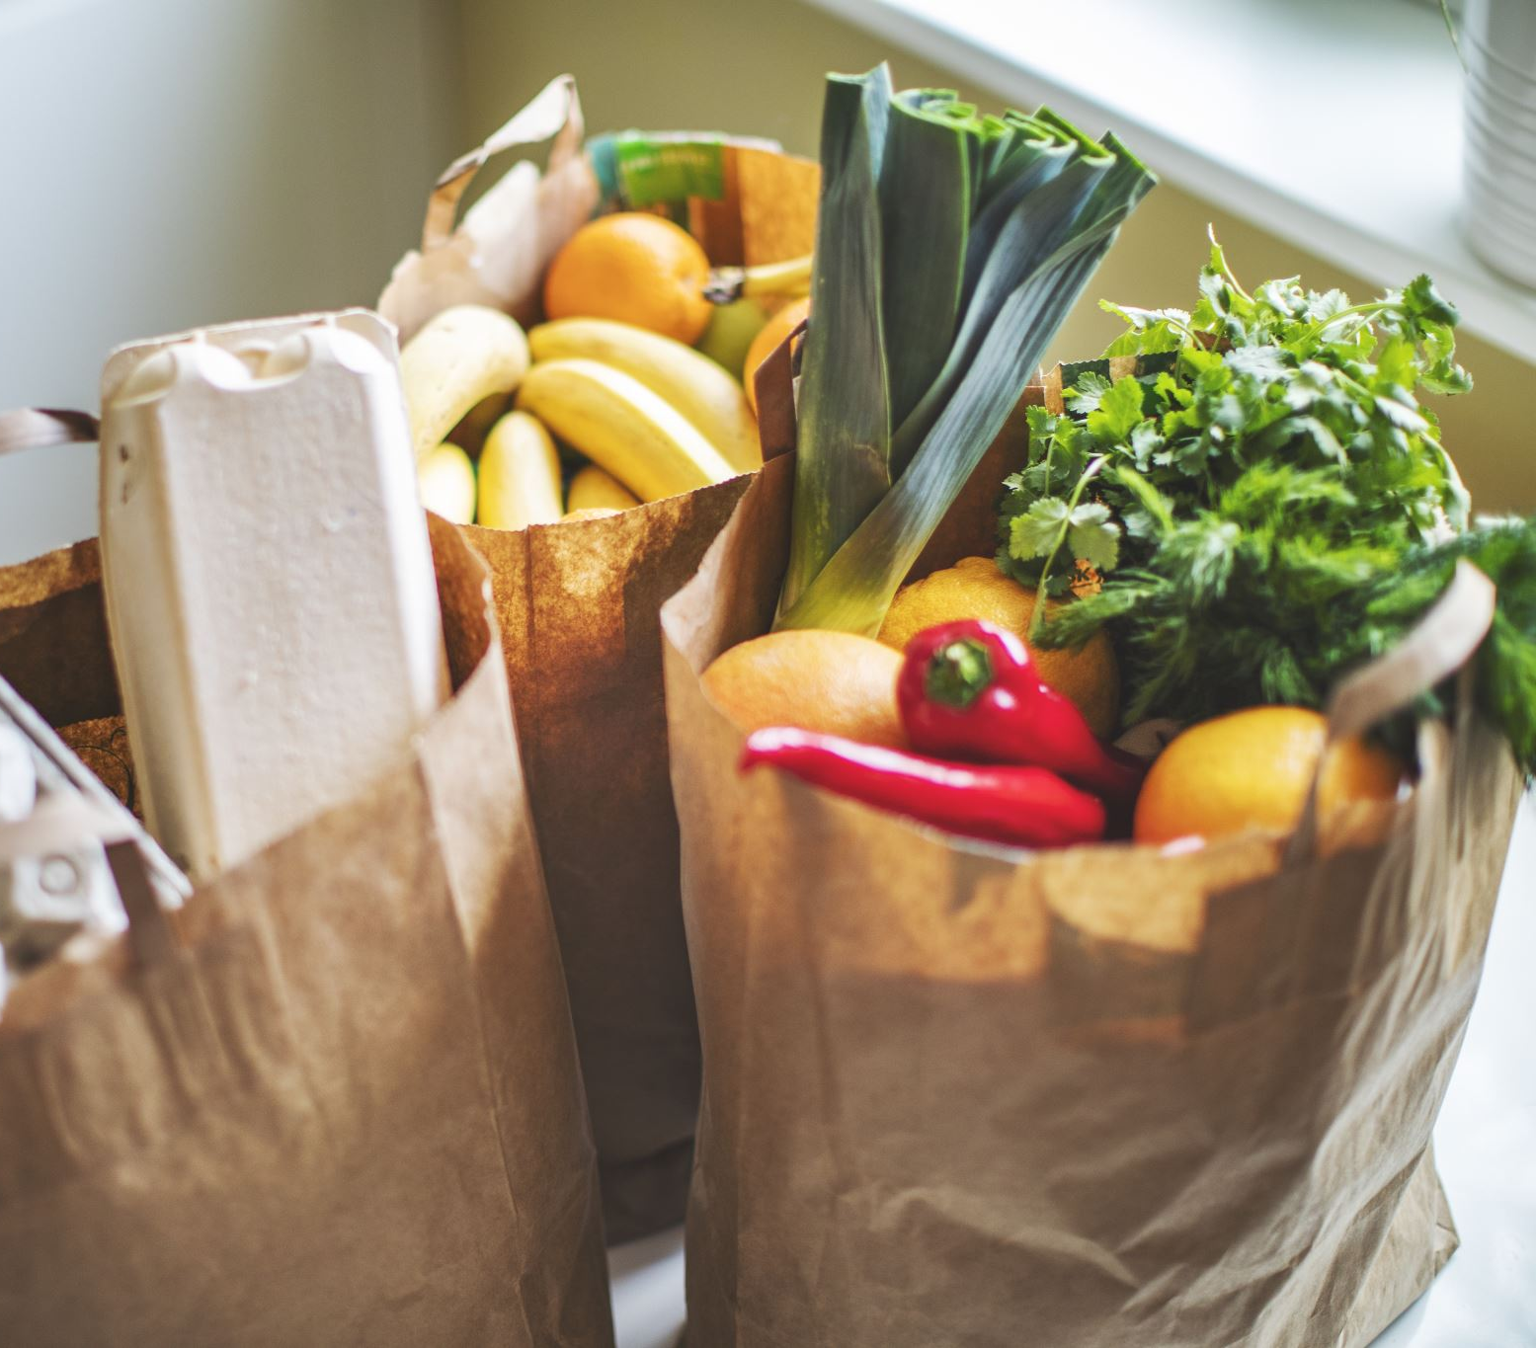
Business Insights
Performance of ABC Groceries
Retailing Operation
Lu Bai – Business Analyst
June 2022

Slide 2
Objective
ABC Groceries is a chain grocery store retailer throughout the country. The new regional manager wants to collect information about the stores under her management. She wants to know the previous performance of the stores and the customer engagement. She’d also like to get some business insights from the data.
Data Collected
Transactions table: records each transaction’s ID, time, and amount between April 2012 and March 2014
Customers table: records each customer’s account number, gender, and segmentation type
Stores table: records each store’s location code, store type, and geographic information

Slide 3
KPIs
Total Sales
Number of Transactions
Average Sales per Transaction
Number of Customers
Store Information

Slide 4
Overall Sales Trend
Observed: The monthly sales remain slightly above $45,000 before June 2013, but it drops dramatically by $5000 in July 2013. All the following monthly sales become below $45,000.
WHY?: It seems like the drop in July 2013 is not just a SPIKE by chance. It looks like a STEP DROP, affected by the change in the company’s operation.
Next Step: Need to trace back what happened in July 2013, any internal operational policy change? Did we adjust the price of the items? Were there any Suppliers’ changes thus affecting the quality of the items? Were there any external strong competitors emerging into the market? Or was there any existing competitor change their marketing strategy thus attracting customers from us?

Slide 5
Monthly Number of Transactions & Unique Customers
Observed #1: Interestingly find out that it has the same number of transactions each month, 510, until March 2013, followed by a sudden increase to 600 in April 2013, and remained the same again after.
WHY?: Three convenience stores grandly opened in April 2013, which brought more transactions. While that means each new convenience store generates on average 30 more transactions per month, can this bring enough sales to our company? What is the operational cost? What’s the profit for each store?
Next Step: Need to collect more relevant data and dive deeper to see the operation efficiency of each store.
Observed #2: Also noticed that the number of unique customers equals the number of transactions, which means those customers did not come back shopping more than once every single month. But did we get new customers each month or just existing customers? Talk more on this later…

Slide 6
Average Sales per Transaction
$64~$68
in 2015 ??
Monthly Avg. Sales per Transaction
Observed: The average sales per transaction is trending down each year. In April 2013, it drops 15.2% because 3 convenience stores opened bringing more transactions without a big increase in revenue. It drops down further in July 2013 in action with the decrease in revenue.
WHY?: 3 newly opened convenience stores bring in transaction volume, but their avg. amount spent per transaction is much less than the spent in large stores, which drags the average down dramatically between 2012 and 2013. While the avg. spent amount keeps dropping in 2014. That means customers pick up fewer items each time. What did they buy each time? Did they mainly pick up items on sale? Is our price too high thus customers switching to somewhere else?
Next Step: Need to pay close attention and have counteractions ASAP to prevent continuous drops like the forecasting trend shown above.

Slide 7
Geographic Distribution
Observed: Central Zone has 9 stores, contributing 36.4% of the total sales for these years; while west zone has 11 stores, only 2 more, but its total sales almost double the central zone.
WHY?: 8 of 11 stores in west zone are large stores, while central zone weighs more on convenience stores. The average sales per transaction for different store types might be different, which drives the significant difference in zone total sales. Furthermore, two convenience stores #13 & 20 brandly opened in April 2013, with one convenience store #17 newly opened at the same time, which has an impact on the total sales by zone as well.

Slide 8
Geographic Distribution. Continued…
Observed: Both central zone and west zone have an average sales per transaction of around $110 for the large stores, and around $25 for each convenience store. The sales per transaction is not affected by the difference in zone factor.
WHY?: Different store type has different target customers. The large store mainly serves the surrounding neighbors for their daily supplies, while convenience stores usually sell products at a higher price for convenience.
Next Step: To further evaluate the performance of each store, more data is needed, e.g. Costs for analyzing the profit of each store.

Slide 9
Customer Shopping Behaviors
In the dataset, the company has segmented customers into six categories based on what kind of items they mainly purchased.
Observed: Each year, the ‘Traditional’ type of customer contributes the most of the sales, with the ‘Economy’ type the second. ‘Traditional’ customers mainly buy daily expense products, like milk, bread and eggs. No matter which type of customers, we can see the avg. sales per transaction is dropping each year, with the ‘Traditional’ type of customers drop most dramatically.
WHY?: Why these customers buy milk, bread and eggs elsewhere? Is our price too high compared to competitors? Or is the quality bad? The varieties of items are limited? Did we deserve the customers? Employees’ bad altitude thus bad impression on the company?

Slide 10
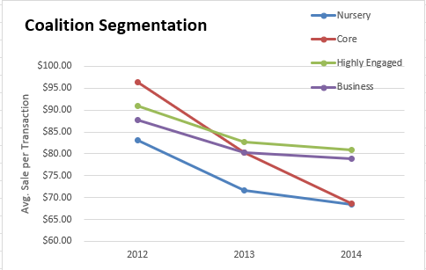
Coalition Customer Segmentation
Observed: During all 3 years, ‘Core’ customers spent the most among others. In regards of avg. sales per transaction, ‘Core’ Customers have the highest amount, while it drops significantly in 2013, 2014. The overall trend of avg. sales per transaction for every single segment is decreasing.
WHY?: Why does the company lack attractions to ‘Core’ customers? Any internal reason? External reason?
Next Step: Need to consult with the marketing and sales departments to learn more about the segmentation.

Slide 11
New Customers VS. Returning Customers
New Customers | Jan | Feb | Mar | Apr | May | Jun | Jul | Aug | Sep | Oct | Nov | Dec
2012 |  |  |  | 510 | 0 | 0 | 0 | 0 | 0 | 0 | 0 | 0
2013 | 0 | 0 | 0 | 90 | 0 | 0 | 0 | 0 | 0 | 0 | 0 | 0
2014 | 0 | 0 | 0
Observed: We know already each month unique customers come to shop, but they are not new customers. The company only attracted new 510 customers in April 2012, after that no new customers at all. The company attracted another 90 customers in April 2013 when 3 other convenience stores grandly opened.
WHY?: How can the company fail to attract new customers for a year after opening? Why did existing customers visit stores on a pattern of once per month for continuous 24 months?
Next Step: Need to closely look at customers’ behaviors, set a thorough plan for customer acquisition and retention

Slide 12
Overall Evaluation
The overall performance of ABC Groceries is very unhealthy.
All KPIs are trending DOWN
We should be alarmed and come up with large-scale counter-actions ASAP to prevent further down-trending
KPIs | Performance Evaluation
Total Sales | Step Drop
Number of Transactions | Stay Flat
Average Sales per Transaction | Trending Down
Number of Customers | Fail to attract new customers; Existing customers only shop once a month

Slide 13
Suggestions
1. different department needs to collaborate to find out what drove the total sales step drop in April 2013, and to find out what are the reasons why average sales per transaction decreases, internal reasons and/or external reasons.
For Internal:
Update operational policies to better serve customers. E.g. return policy, store hours
Implement better pricing strategies to attract more customers, e.g. combo sales, time limit coupons
Develop marketing plans, perform various marketing campaigns to increase brand awareness and market share
Quality control on suppliers
Better plan Merchandising Mix for shelf placement, promotional placement, and fresh food display, etc
Provide better customer service. E.g. set up customer service standards and train the employees.
For External:
Analyze the main competitors and set our strategies to remain competitive
Be aware of the market changes, like newly emerging competitors
Be open-minded: get benefits from new technologies, and new marketing channels, like social media, on-line stores…

Slide 14
Suggestions
2. Based on the data, there are no returning customers. We definitely need to work on customer acquisitions and customer retention.
For Customer acquisitions:
Better perform customer segmentation, and find target customers
Utilize different marketing strategies to attract more customers. E.g. social media exposure, youtube ads, Paid search…
For Customer Retention:
Analyze customers’ behaviors to provide better options. E.g. customer survey, email campaign for targeted advertising
Create a membership system, and develop customers’ loyalty. E,g Membership card can collect points, membership discounts
Perform periodic customer churn analysis to trace the performance
3. Different store type needs to have different marketing and sales strategies toward different target customers

